Slide 1
A1 Chemistry
Balancing equations

Slide 2
Learning Intentions
chemical reactions can be represented by chemical equations; balanced chemical equations indicate the relative numbers of particles (atoms, molecules or ions) that are involved in the reaction

Slide 3
Success Criteria
Write balanced ionic equations, given reactants’ and products’ names.

Slide 4
Key words
Law of Conservation of Matter
coefficient
reactant
Product
Weak/strong ionisation/dissociation
Spectator ion

Slide 5
Chemical equations
reactants → products
Law of Conservation of Matter explains that atoms are not created or destroyed, but rearranged, when substances undergo a chemical reaction.
The number of each type of atoms in the reactants are the same as in the products.
Coefficients show the ratio of each substance in a reaction (of actual numbers of atoms, molecules or ions AND of moles of atoms, molecules or ions)

Slide 6
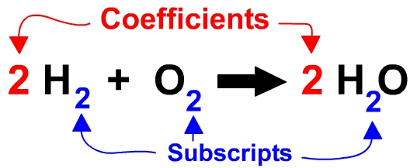

Slide 7
Balancing equations
Balancing equations

Slide 8
Tips
Balance largest formulae first.
Balance any element that appears more than once on either side last
Treat polyatomic ions that remain intact as a single unit to balance
Balance C first, O last in combustion reactions
H₂SO₄ _{(aq)} + KOH _{(aq)} → K₂SO_{4 (aq)} + H₂O_{(l)}

